Slide 1

CLIENT TELEMETRY AI SYSTEM
Vanguard Client Telemetry AI System
Detecting Frustration.
Prioritizing Impact. Improving Client Experiences.
May 19, 2026
CI493 Senior Project
Team Vanguard
AI-Powered Insights for Better Decisions
Sabrina Akter | Shengyang Dong | Junkai Ge | Manish Gurung | Geri Koka | Guanxin Zheng

Slide 2





CLIENT TELEMETRY AI SYSTEM
Meet the Team
Sabrina Akter
Dashboard & Visualization
Phase 3
Geri Koka
Dashboard & Visualization
Phase 3
Manish Gurung
AI & Model Engineering
Phase 2
Our Three-Phase Approach
Phase 1
Telemetry & Data Pipeline
Phase 2
AI & Model Engineering
Junkai Ge
AI & Model Engineering
Phase 2
Shengyang Dong
Telemetry & Data Pipeline
Phase 1
Guanxin Zheng
Telemetry & Data Pipeline
Phase 1
Phase 3
Dashboard & Visualization
Vanguard Client Telemetry AI System | CI493 Senior Design
2

Slide 3
CLIENT TELEMETRY AI SYSTEM
Problem Statement
Modern financial platforms generate massive amounts of user interaction data across web, mobile, and support channels.
Most client sessions are completed successfully
A small subset of sessions (“tail experiences”) contain unusually high friction
These sessions may include:
rage clicks
navigation loops
repeated errors
failed workflows
High-frustration experiences negatively impact:
customer satisfaction
trust
platform perception
Identifying these sessions in real time is difficult due to the scale and complexity of telemetry data
Key Goal
Detect high-frustration user experiences using synthetic telemetry and AI-driven scoring.
Vanguard Client Telemetry AI System | CI493 Senior Design
3

Slide 4
CLIENT TELEMETRY AI SYSTEM
Project Objectives
Detect high-frustration client sessions using synthetic telemetry data and AI-driven scoring
Transform raw user behavior data into structured session-level features for analysis
Use an ensemble model (Autoencoder + Isolation Forest) to generate frustration scores and severity levels
Deploy automated scoring and monitoring with AWS SageMaker, S3, Lambda, and EventBridge
Deploy the scoring system using AWS SageMaker, S3, Lambda, and EventBridge to support automated model execution, scalable inference, and real-time monitoring
Visualize sessions, alerts, and admin feedback through a centralized dashboard for better decision-making
Vanguard Client Telemetry AI System | CI493 Senior Design
4

Slide 5
CLIENT TELEMETRY AI SYSTEM
High-Level Architecture Diagram
Vanguard Client Telemetry AI System | CI493 Senior Design
5

Slide 6
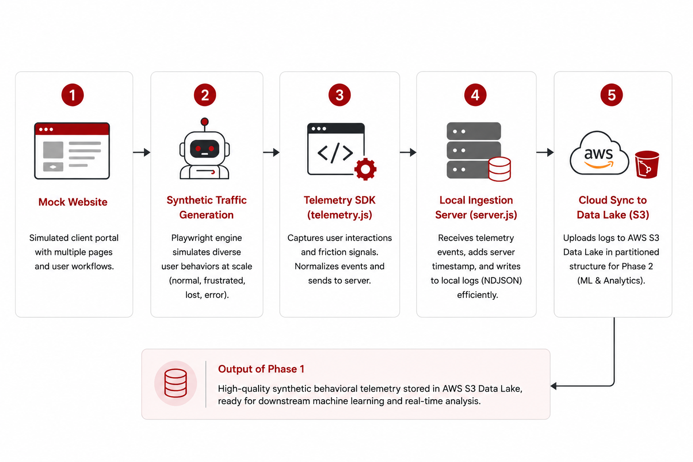
CLIENT TELEMETRY AI SYSTEM
Phase 1 - Overview
Phase 1 focuses on building the end-to-end telemetry generation pipeline within a fully isolated mock environment. Synthetic user interactions are generated, captured as behavioral telemetry, and synchronized to AWS S3 for downstream machine learning and analytics.
Key Objectives
Simulate realistic client behaviors at scale
Capture friction and interaction telemetry
Build a scalable ingestion pipeline
Prepare structured data for AI analysis
Vanguard Client Telemetry AI System | CI493 Senior Design
6

Slide 7
CLIENT TELEMETRY AI SYSTEM
Phase 2: AI / Model Engineering
Architecture Diagram
Vanguard Client Telemetry AI System | CI493 Senior Design
7

Slide 8
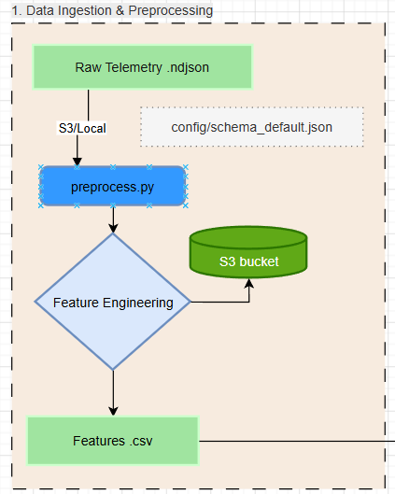
CLIENT TELEMETRY AI SYSTEM
Part 1 : Data Ingestion & Preprocessing
Key Points
Handling of raw telemetry data in ".ndjson" format from both AWS S3 and Local file system
Allowing system to adapt to different telemetry format without any significant code changes
Preprocess by grouping individual events into cohesive user sessions
Raw / Unstructured events are transformed into 13 specific numerical features that quantify user frustration
Store processed data into S3 bucket for visualization & analytics
Vanguard Client Telemetry AI System | CI493 Senior Design
8

Slide 9
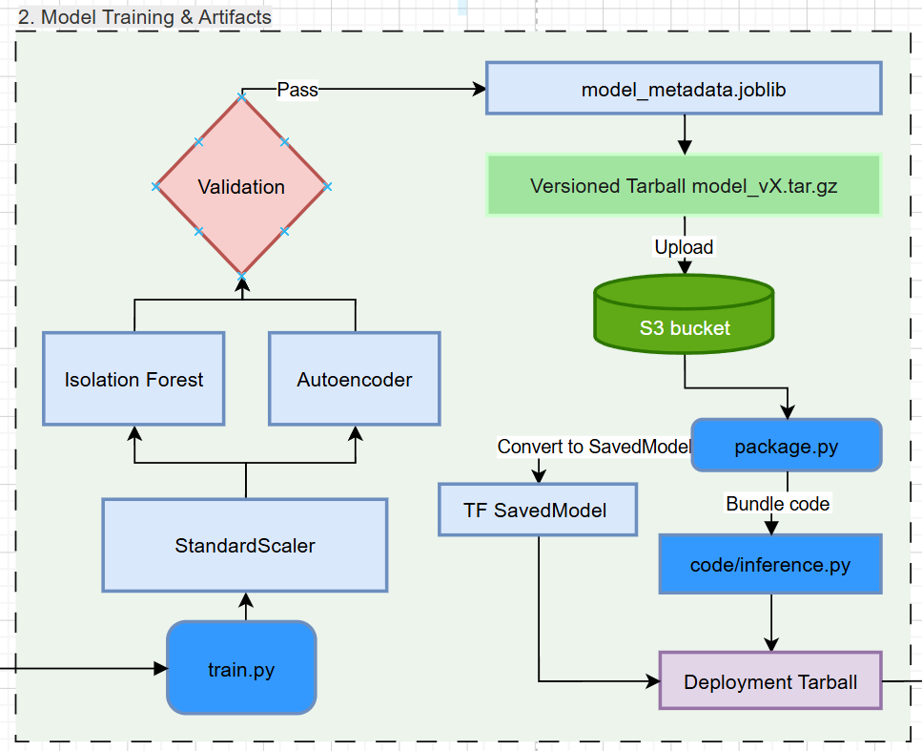
CLIENT TELEMETRY AI SYSTEM
Part 2: Model Training & Artifacts
Key Points
Ensemble approach combining two models Autoencoder and Isolation forest to identify anomalies
Normalization of pre-processed features to prevent high magnitude features from disrupting the predictions
Strict validation to ensure only best model is passed into production
Model versioning to ensure safe model switch
Vanguard Client Telemetry AI System | CI493 Senior Design
9

Slide 10
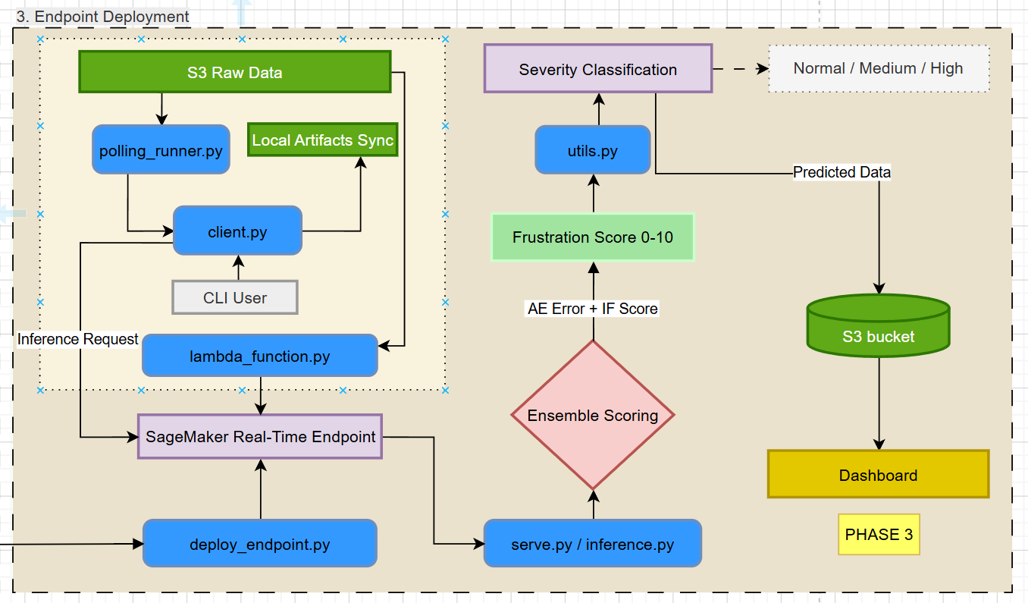
CLIENT TELEMETRY AI SYSTEM
v
Part 3 : Deployment
Key Points
Real-time deployment with SageMaker Endpoint for high-performance and scalable API requests
Local model syncing for scoring without any network overhead in case of API failures
Automated triggers with lambda function to provide event driven triggers to monitor S3 raw data continuously
Severity classification with final 0-10 score translated into classified labels (Normal, Medium, High) for decision making and visualization
Vanguard Client Telemetry AI System | CI493 Senior Design
10

Slide 11
CLIENT TELEMETRY AI SYSTEM
Phase 3: Dashboard + Visualization
Purpose
Phase 3 provides a centralized dashboard for monitoring, analyzing, and prioritizing high-frustration user sessions generated throughout the pipeline.
Dashboard Views
Sessions Page
Displays all processed sessions
Shows severity, scores, timestamps, and session status
Alerts Page
Highlights high-frustration sessions requiring attention
Prioritizes critical user experiences
Queue Page
Organizes sessions by status, severity, and timestamp
Simulates frustration-aware prioritization
Session Detail Page
Displays:
aggregated metrics
behavioral metrics
prediction results
event timeline
session metadata
Admin Page
Allows manual severity overrides
Supports feedback/comments
Simulates human-in-the-loop review workflow
Key Features
Cross-page data consistency across all dashboard views
Automatic refresh using latest available run data
Accurate session-to-prediction mapping
Severity-based prioritization and filtering
Missing/incomplete data handling with fallback values
Override functionality for admin review and validation
Vanguard Client Telemetry AI System | CI493 Senior Design
11

Slide 12
CLIENT TELEMETRY AI SYSTEM
Demo Overview
Vanguard Client Telemetry AI System | CI493 Senior Design
12

Slide 13
CLIENT TELEMETRY AI SYSTEM
Testing Strategy
Unit Testing
Validate metric calculations, severity classification, and API response structure
Ensure correct feature values and score mapping logic
Integration Testing
Verify data flow across all three phases
Ensure telemetry → features → predictions → dashboard works correctly
System Testing
Test full pipeline execution from data generation to dashboard visualization
Confirm latest data loading, alerts, queue logic, and admin functions
UI & Data Consistency Testing
Validate dashboard accuracy across Sessions, Alerts, Queue, and Admin pages
Ensure consistent values, formatting, and missing data handling
Vanguard Client Telemetry AI System | CI493 Senior Design
13

Slide 14
CLIENT TELEMETRY AI SYSTEM
Phase 2: AI Team - Test Cases
01: Aggregated Metrics Accuracy
Verify preprocess.py correctly computes session metrics
Validate event_count and session_duration_ms match raw telemetry data
Result: PASS — metrics are consistent and accurate
02: Severity Logic Correctness
Test utils.py severity classification thresholds
Validate score mapping: Normal / Medium / High
Result: PASS — scoring logic works correctly and consistently
03: Inference Workflow (Local)
Verify client.py local inference and model sync fallback
Simulate failed S3 download and confirm fallback to stable model
Result: PASS — model syncing and fallback work properly
Vanguard Client Telemetry AI System | CI493 Senior Design
14

Slide 15
CLIENT TELEMETRY AI SYSTEM
Phase 3: Dashboard Team – Test Cases
• 01: Session-to-Prediction Mapping
Verify Sessions, Alerts, Queue, and Session Detail pages display consistent session data
Validate severity labels, timestamps, and prediction scores remain synchronized across views
Result: PASS - dashboard views maintain consistent session mapping
• 02: Event Timeline API Integration
Verify /api/sessions/{sessionId}/events retrieves telemetry events from AWS S3 raw NDJSON logs
Validate backend parsing, API response structure, and frontend timeline rendering
Result: PASS - event timeline integration and rendering function correctly
Current Limitation: exact session-to-event alignment is still being refined due to identifier inconsistencies between processed session data and raw telemetry logs
• 03: Severity-Based Alerts & Queue Prioritization
Verify high-severity sessions appear correctly within Alerts and Queue views
Validate severity filtering and prioritization logic
Result: PASS - prioritization and filtering behave correctly
• 04: Admin Override Workflow
Verify manual severity overrides update dashboard session state correctly
Validate override comments and persistence logic
Result: PASS - override workflow functions correctly
Vanguard Client Telemetry AI System | CI493 Senior Design
15

Slide 16
CLIENT TELEMETRY AI SYSTEM
Final Outcomes
Phase 3: Final Outcomes
Developed a centralized dashboard for session monitoring, alerts, queue management, and admin review
Implemented cross-page session consistency across Sessions, Alerts, Queue, and Session Detail views
Integrated frontend dashboard views with backend Flask APIs for real-time session and prediction retrieval
Developed Session Detail visualization including behavioral metrics, prediction results, and telemetry metadata
Integrated raw telemetry event timeline visualization using AWS S3 NDJSON event logs
Implemented severity-based filtering and prioritization across Alerts and Queue views
Developed admin override and feedback functionality to support human-in-the-loop review workflows
Identified and analyzed pipeline consistency challenges involving processed session identifiers and raw telemetry alignment across phases
Vanguard Client Telemetry AI System | CI493 Senior Design
16

Slide 17
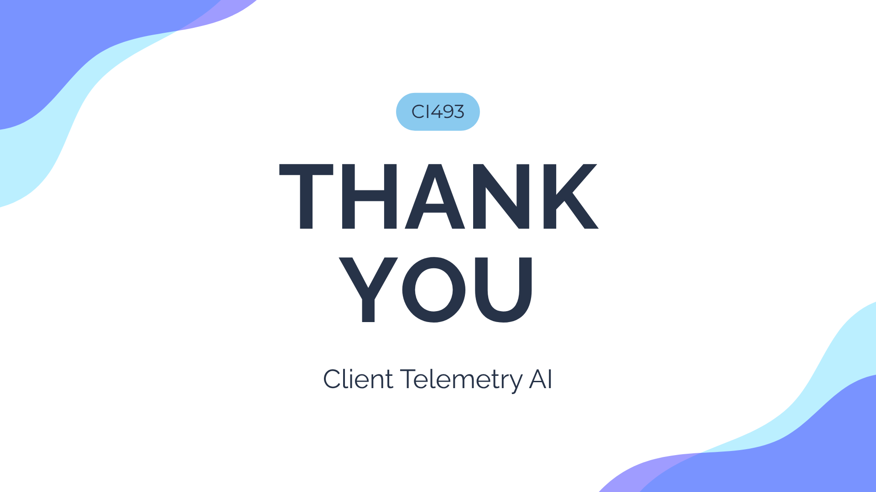
CLIENT TELEMETRY AI SYSTEM
Thank You
Vanguard Client Telemetry AI System | CI493 Senior Design
17

